Slide 1
Software Engineering
ELITE

Slide 2
Course objectives
On completion of the course, participants will be able to:
Describe software lifecycle
Differentiate between traditional and agile methodologies
Able to write user stories and acceptance criteria
To be able to translate acceptance criteria to test cases
To be aware of the process of configuration management, build and deployment

Slide 3
Introduction to Project life cycle

Slide 4


Project
A set of tasks carried out
To achieve the end result
As desired by the customer
Using an optimizing process

Slide 5





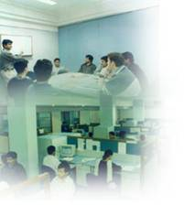
Project Life Cycle
Project Acquisition
Project Initiation
Project Planning
Project Execution
Project Delivery
Project Closure

Slide 6
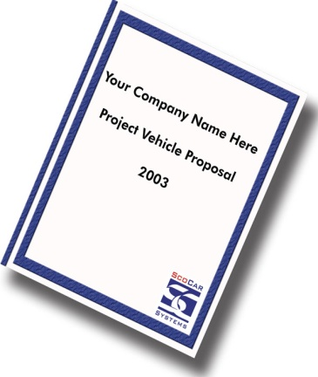
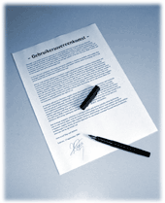
Project Acquisition
Deals with the activities before acquiring a project.
Processing Project Proposals
Contract Review

Slide 7


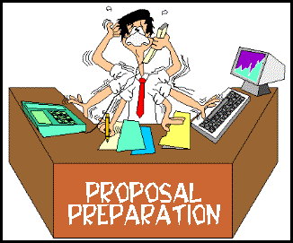



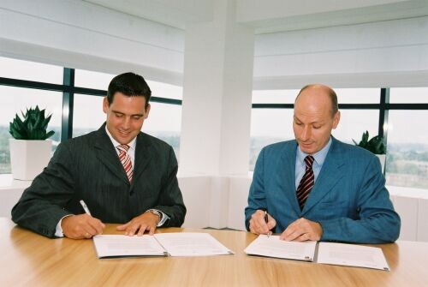

Project Acquisition
Customer
Proposal
Contract
Review
Signing
Project Win

Slide 8



Project Initiation
RCC creates project id in SPR
Team formed with PL
N&S
VSS
CoRCC
Quantify
Finance
Kick Off Meeting
CS

Slide 9
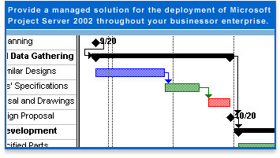
Project Planning
Project Estimation
Risk Management
Defect Prevention
Work Breakdown Structure
Identification of Roles & Responsibilities
Quality Assurance Plan
Configuration Management Plan
Metrics Plan

Slide 10
Project Execution
Task Allocation
Task Execution
Customer Comm.
Configuration Mgnt
SDLC
Review/Inspection
Project Meetings
Metrics
Project Tracking
Defect Prevention

Slide 11

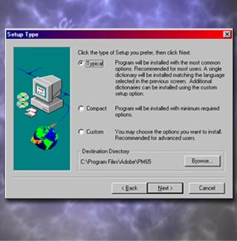

Project Delivery
Software Replication and Delivery
Software Installation
Acceptance

Slide 12

Project Closure
Release of Manpower
Release of Resources
Project Retrospective Meeting
Best Practices & Lessons Learnt
Taking Back Ups
Hand Over Project File

Slide 13
SDLC
The application of business approach to the development of information system solution to business problems, leads to emergence of a multi step process or a cycle.
This cycle is known as Software Development Life Cycle (SDLC)

Slide 14
Introduction to SDLC

Slide 15
Phases – SDLC
Requirements Analysis
User Requirement Specification
Software Requirement Specification
Design
Coding
Testing
Implementation/Deployment
Maintenance
Notes:
The process by which user needs are translated into a software product.
the process involves:
translating user needs into software requirements
transforming the software requirements into design
implementing the design in code
testing the code,
and sometimes installing and checking out the software for operational activities

Slide 16
SDLC -Roles
Developer
User Requirement Specification
Software Requirement Specification
Tester
Notes:
The process by which user needs are translated into a software product.
the process involves:
translating user needs into software requirements
transforming the software requirements into design
implementing the design in code
testing the code,
and sometimes installing and checking out the software for operational activities

Slide 17
SDLC Models

Slide 18
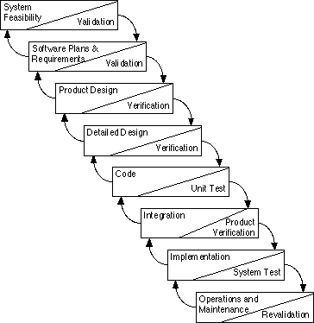
Model - Waterfall

Slide 19
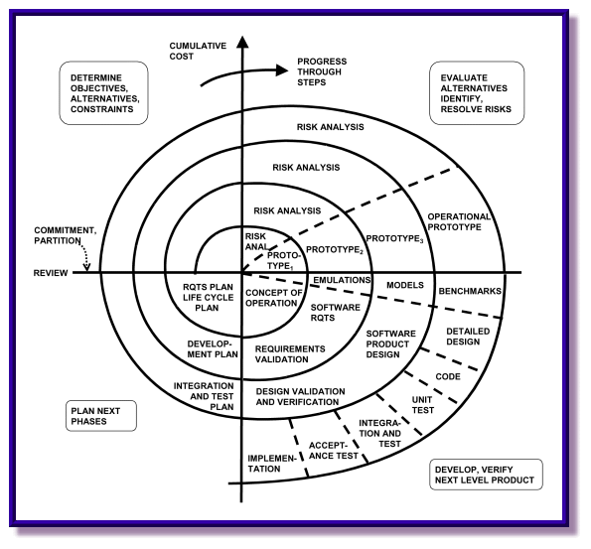
Model -Spiral

Slide 20
Model – ‘V’
Requirements
User Acceptance Testing
Software Req. Specs
System Testing
Development
Testing
Integration Testing
High Level Design
Detailed Design
Unit Testing
Coding

Slide 21
Model-Iterative
Define scenarios to address highest risks
Plan Iteration N
Cost
Schedule
Initial Project Risks
Initial Project Scope
Develop Iteration N
Collect cost and quality metrics
Iteration N
Assess Iteration N
Revise Overall Project Plan
Cost
Schedule
Scope/Content
Revise Project Risks
Reprioritize
Risks Eliminated

Slide 22
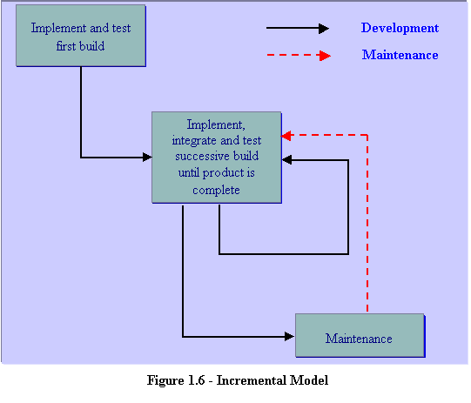
Model - Incremental

Slide 23
Iterative and Incremental Process
Iterative
Manage a stream of executable releases
Incremental
Involves continuous integration of the system architecture to produce these releases
Embodying incremental improvements over the other with each new release.

Slide 24
Methodologies and Models
Methodologies
Development
SSAD
OOAD
Maintenance
Data Warehousing
eLearning
Product Development
Models
Waterfall
V-Model
RAD
Prototype
Incremental
Iterative

Slide 25
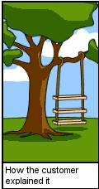

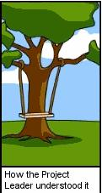
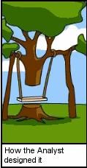
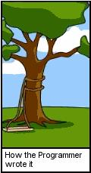
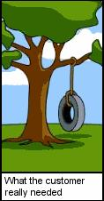
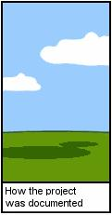
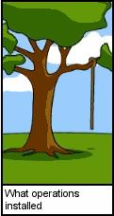

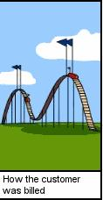
SE in Real Time

Slide 26
Introduction to Requirement Analysis

Slide 27
Walk through on URD –LMS case study

Slide 28
Thank you
Prakash.LNS@TechMahindra.com

